Slide 1
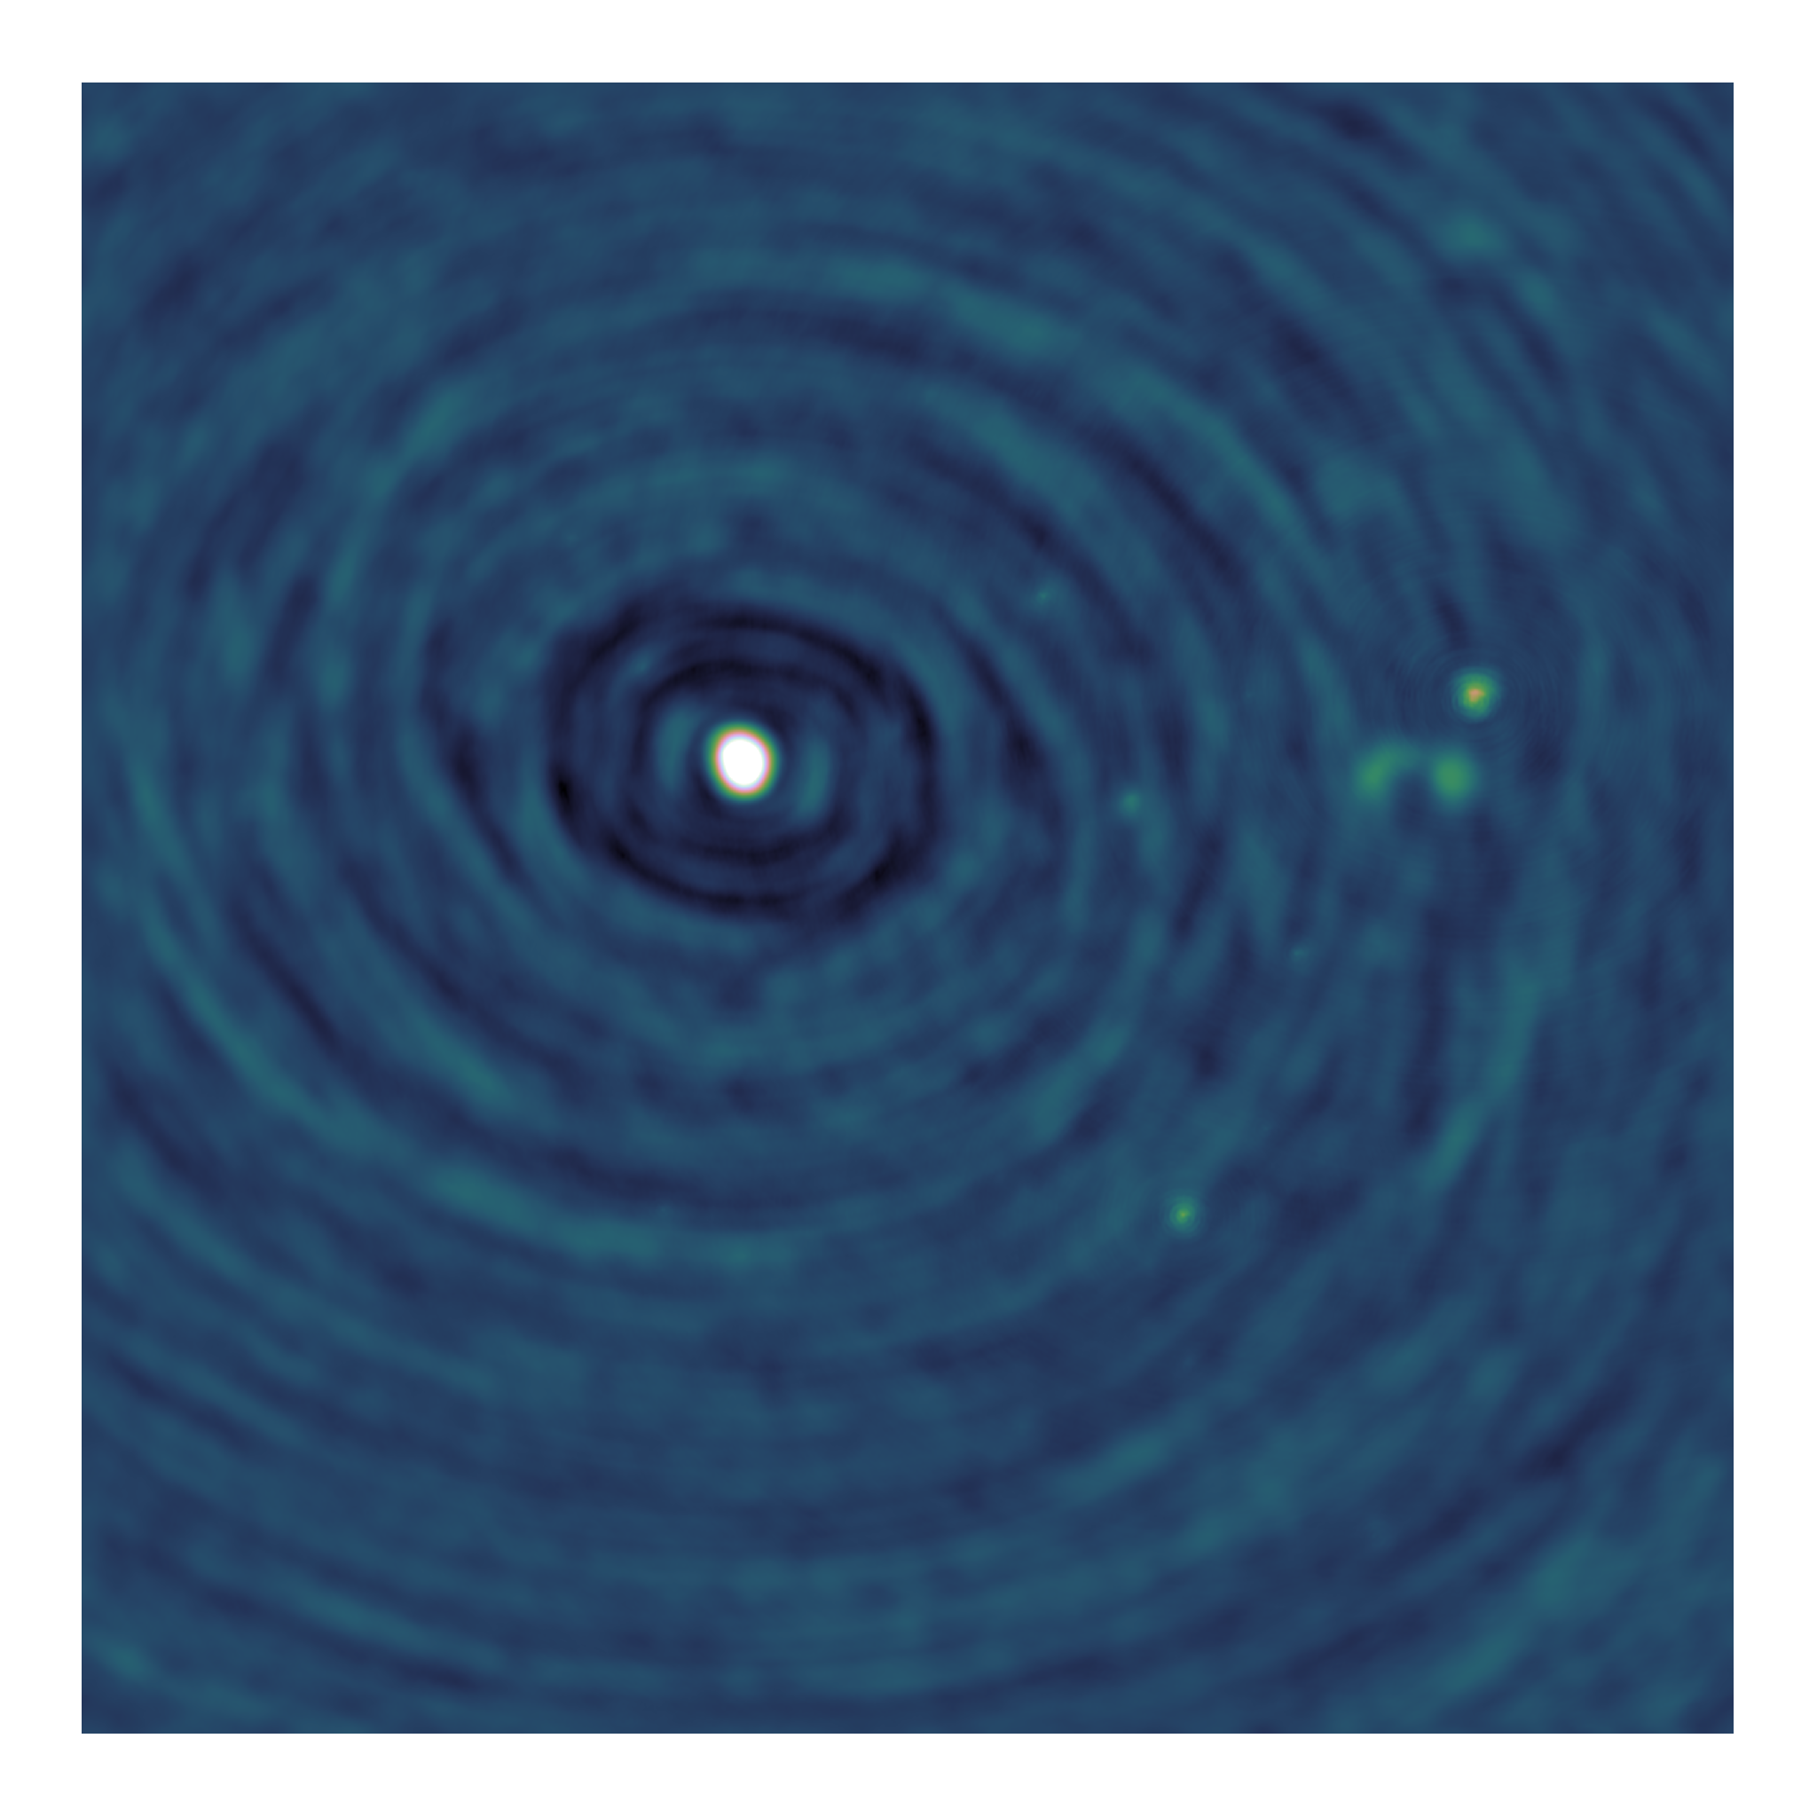
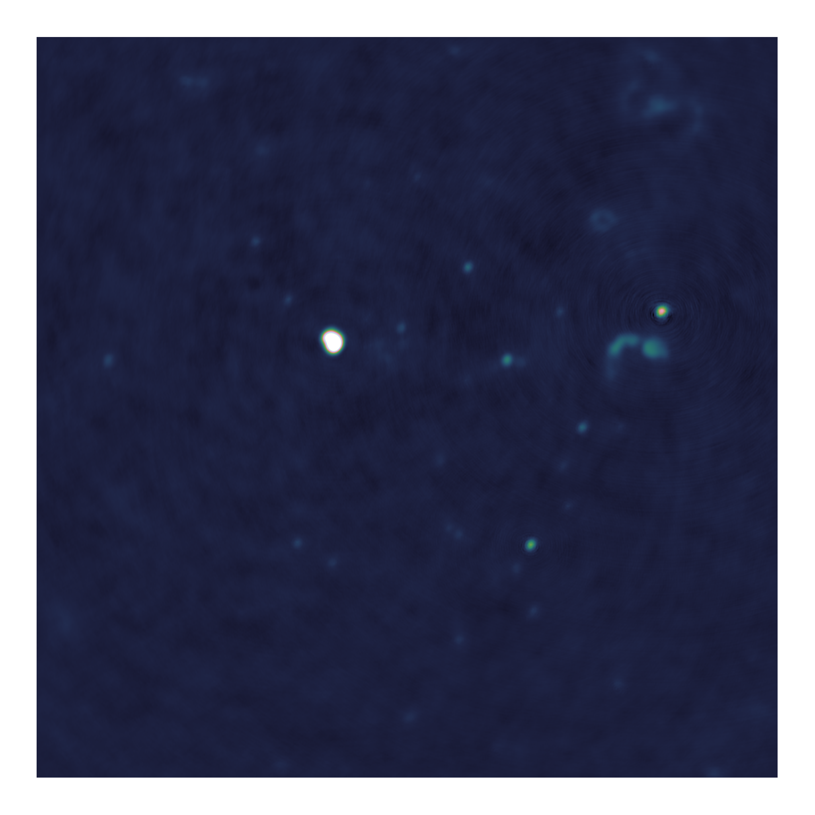
Towards distributed image reconstruction

Slide 2
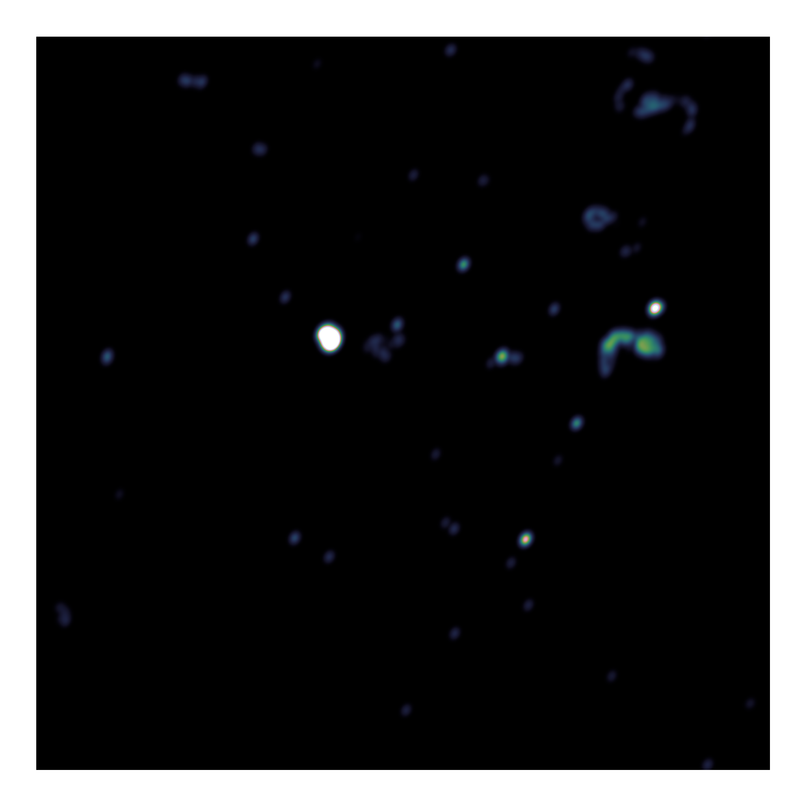
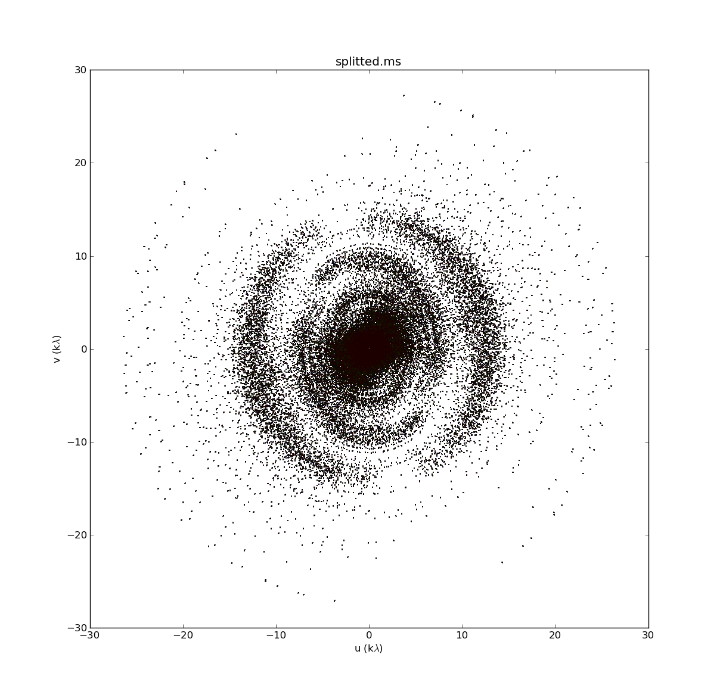
Image Reconstruction
Fourier Measurements
(Visibilities)
Dirty Image
Model Image
Fourier Transform
Deconvolution

Slide 3
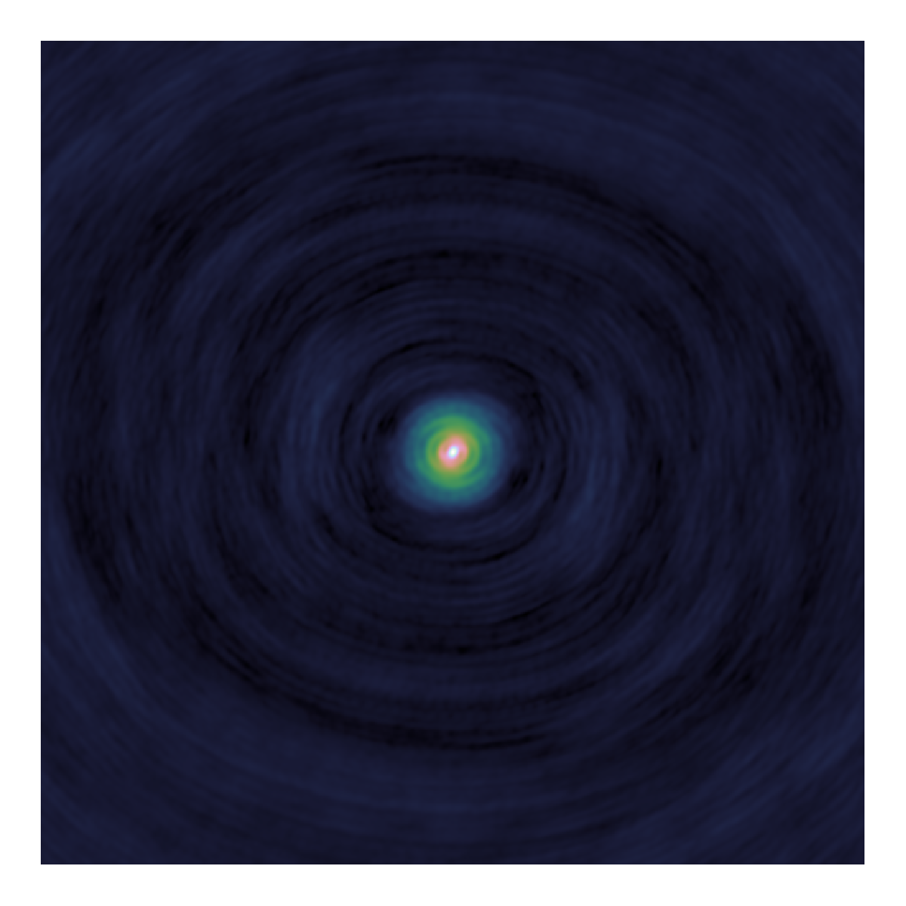
Deconvolution
Dirty
Image
Model
Image
PSF

Slide 4
Major/Minor Cycle
Fourier Transform
Deconvolution
Dirty
Image
Model
Visibilities
Residual
Visibilities
Model
Image
PSF
Fourier Transform

Slide 5
What do I show you?
Deconvolution algorithms
CLEAN
Serial Coordinate Descent
Parallel Coordinate Descent Algorithm + PSF Approximation

Slide 6
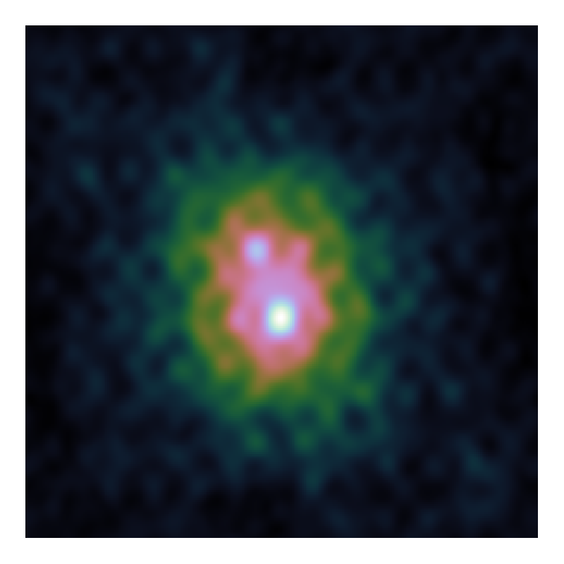
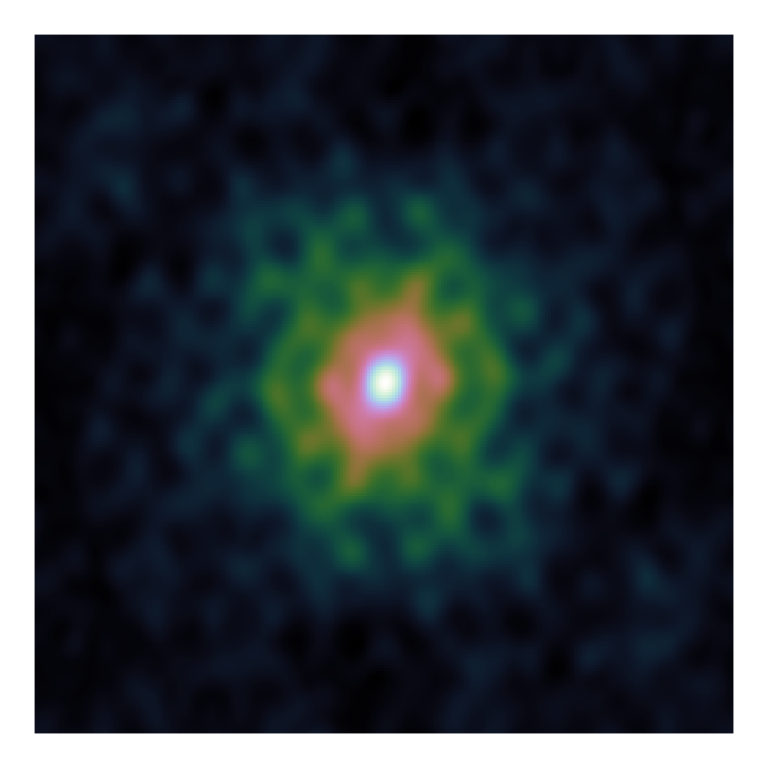
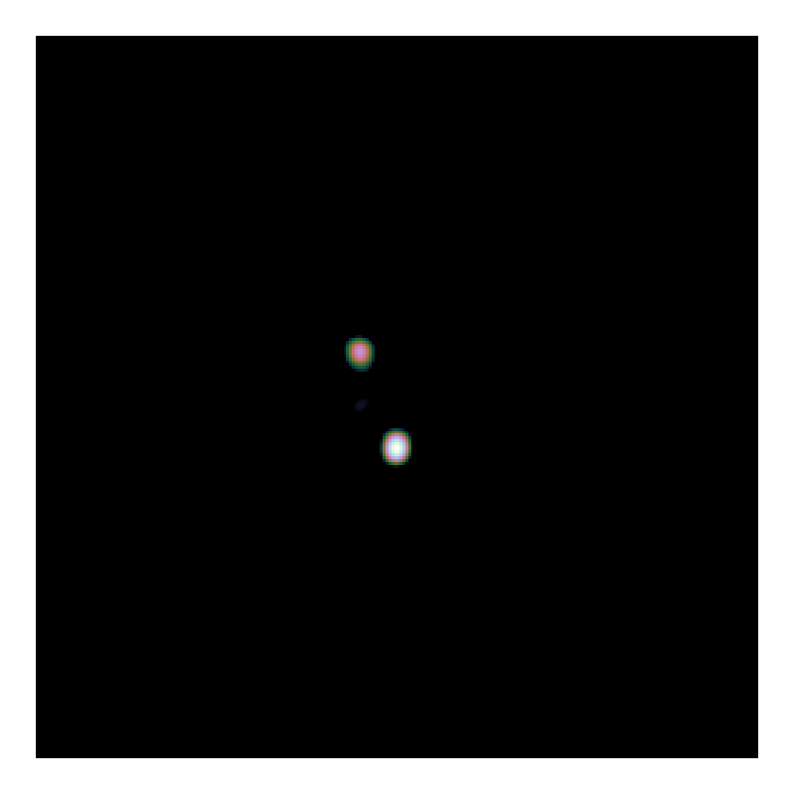
Deconvolution problem

Slide 7
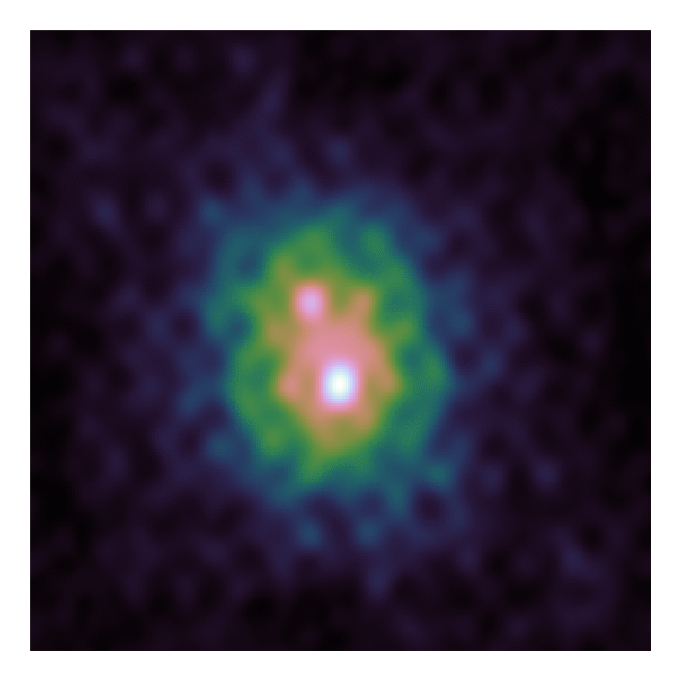

CLEAN
Dirty Image
Model Image

Slide 8
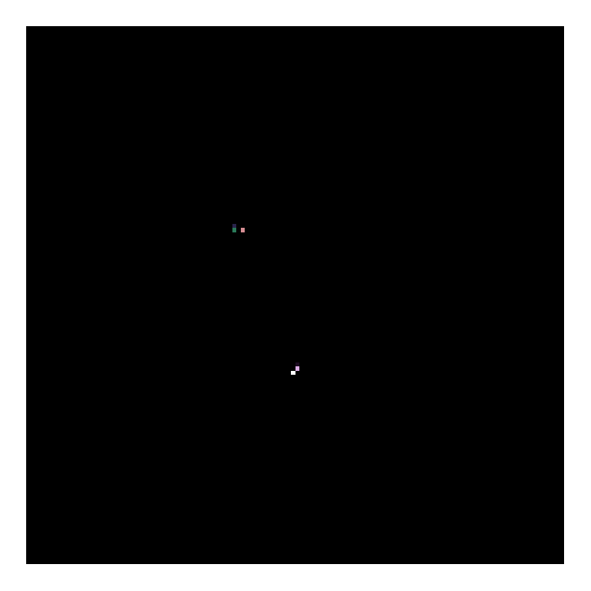
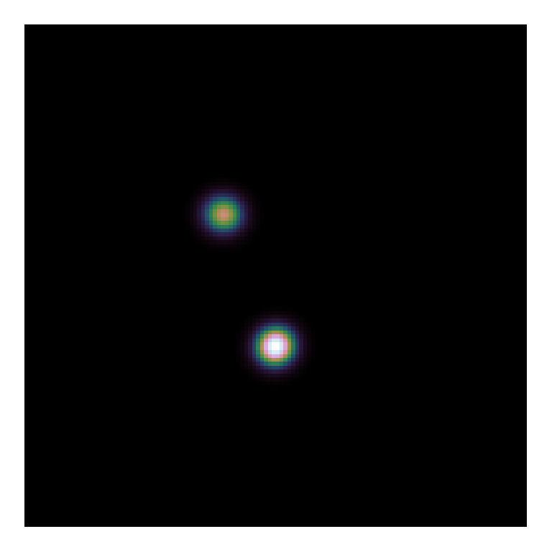
CLEAN
Model Image
Restored Image

Slide 9
Serial Coordinate Descent
Show formula

Slide 10
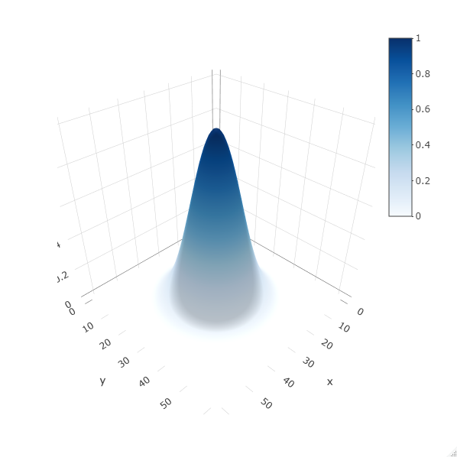
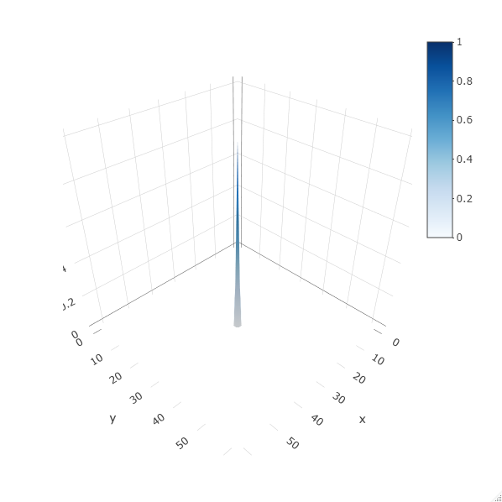
Elastic Net Regularization

Slide 11
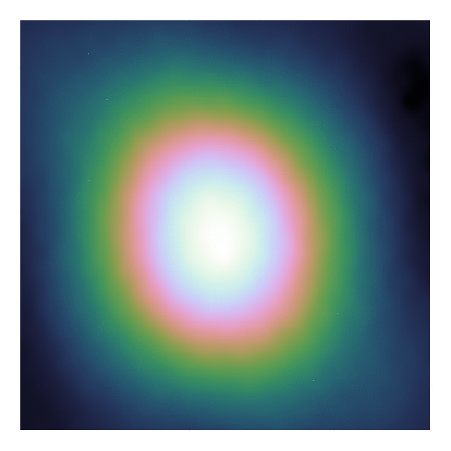

Serial Coordinate Descent
Gradient Map
Model Image

Slide 12
LMC

Slide 13
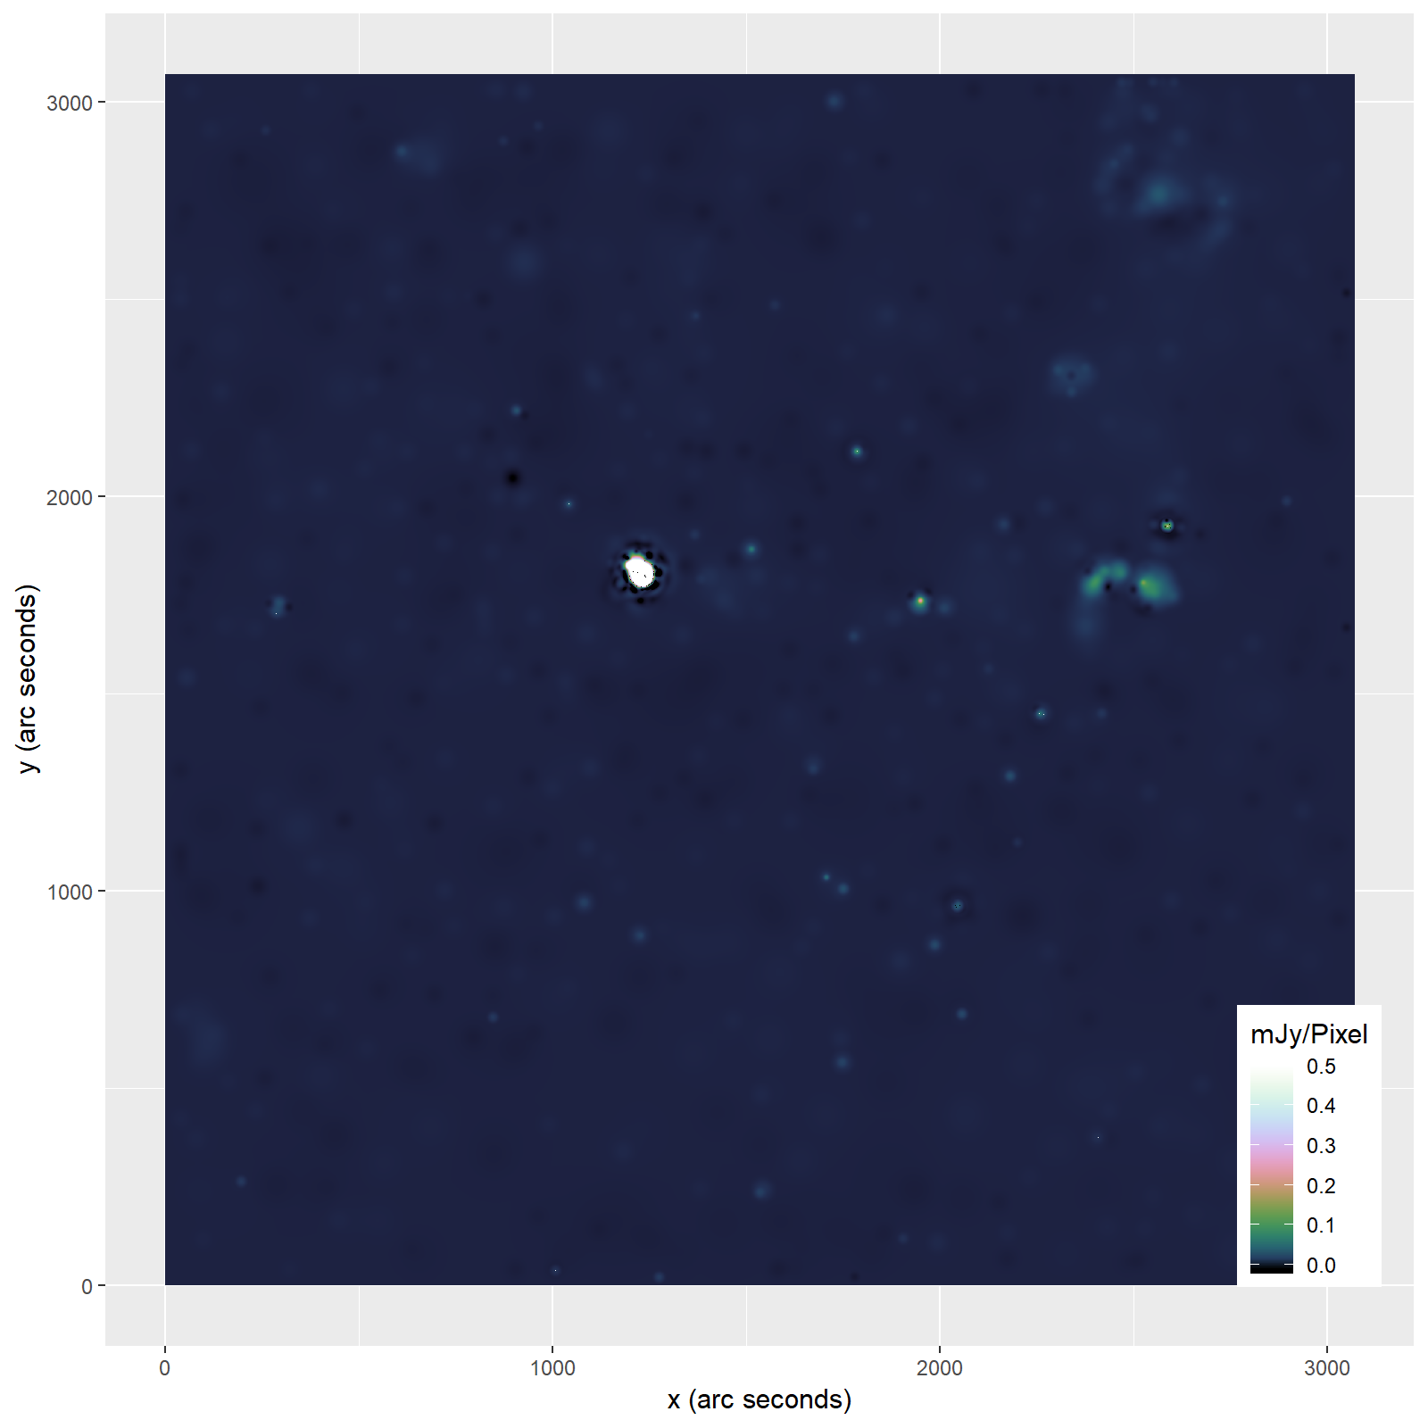

Slide 14
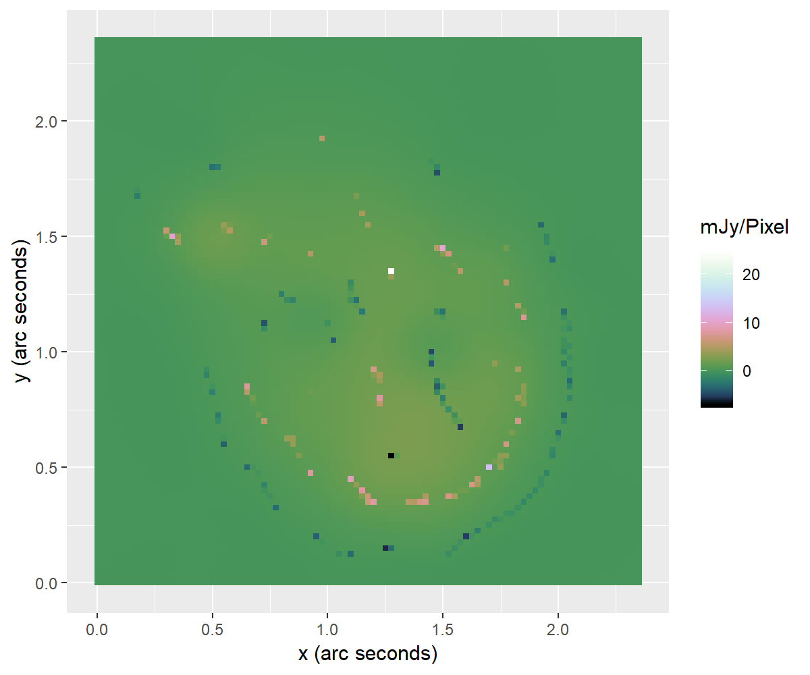
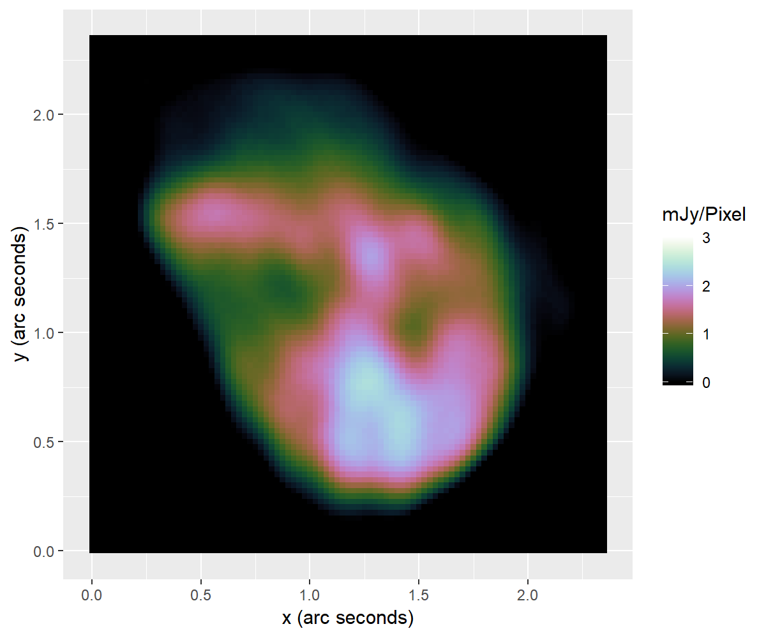
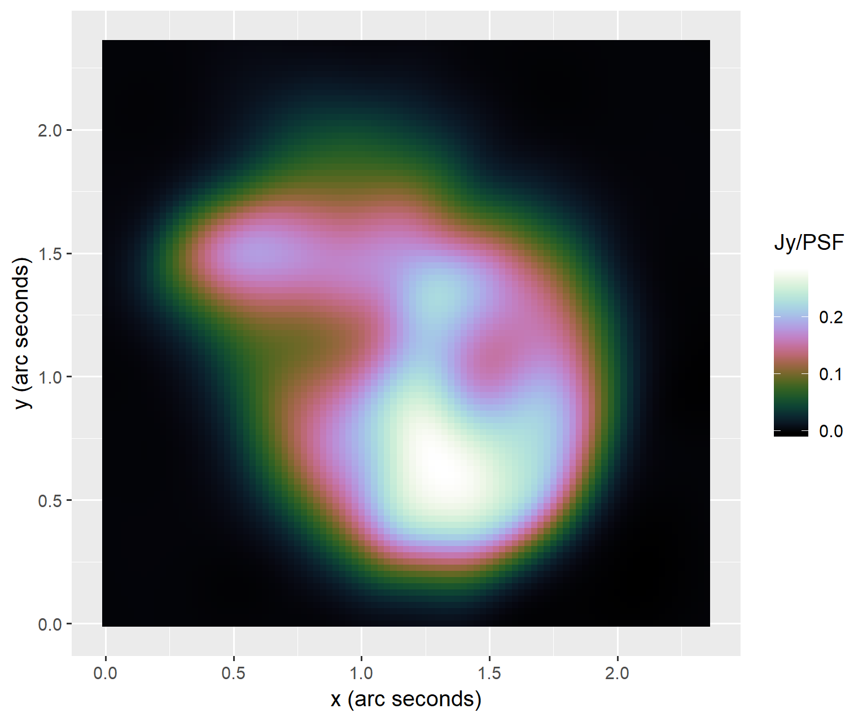
Bright Supernova-Remnant

Slide 15
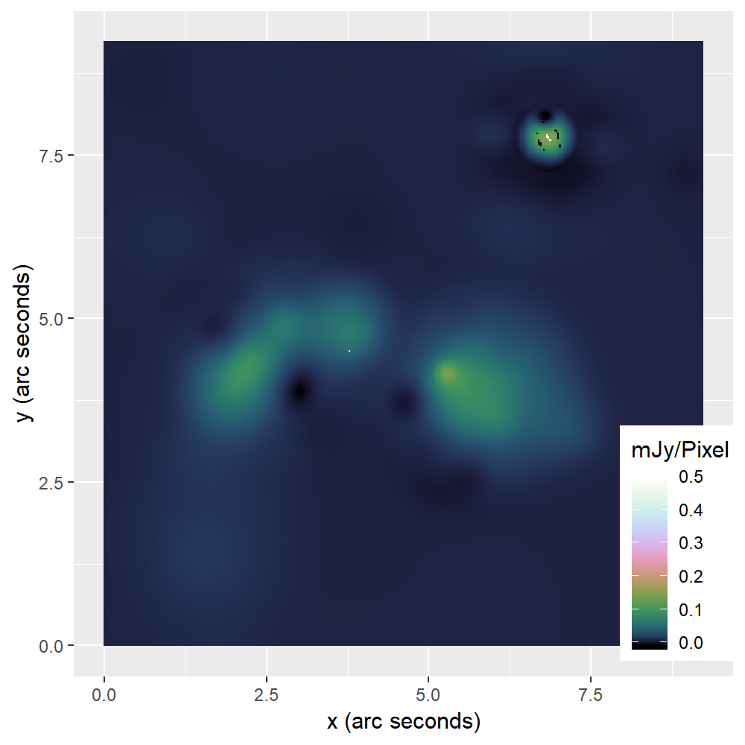
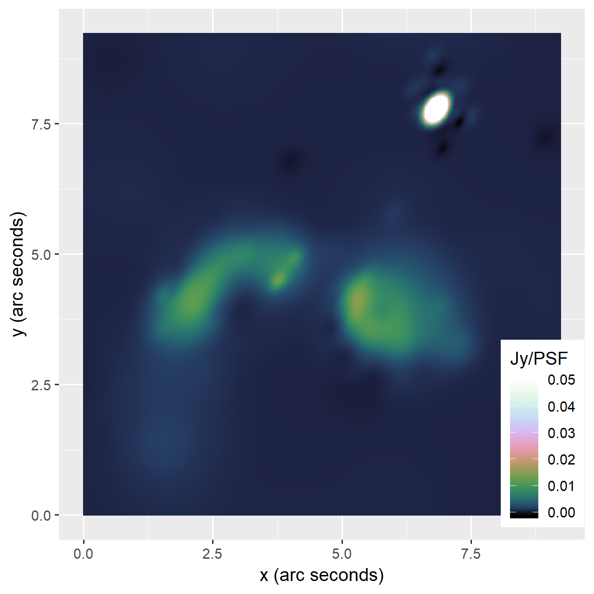
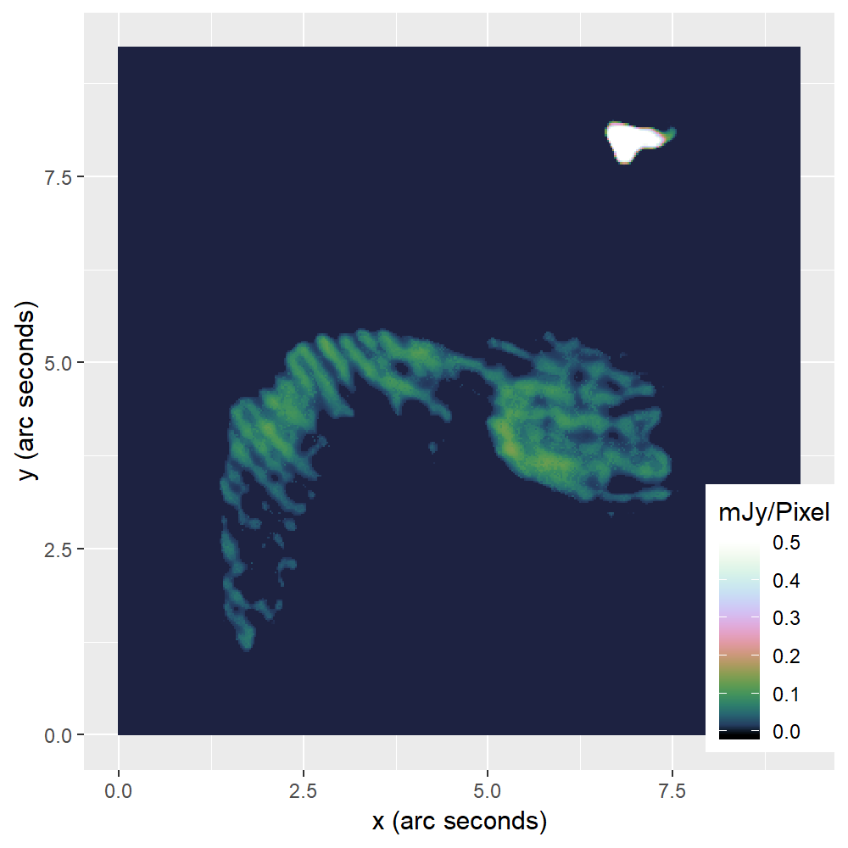
Area with Calibration Errors

Slide 17
Parallel Coordinate Descent
ESO Image

Slide 18
Estimated Separability Over-approximation
Formula
Sparsity

Slide 19
PSF Approximation

Slide 20
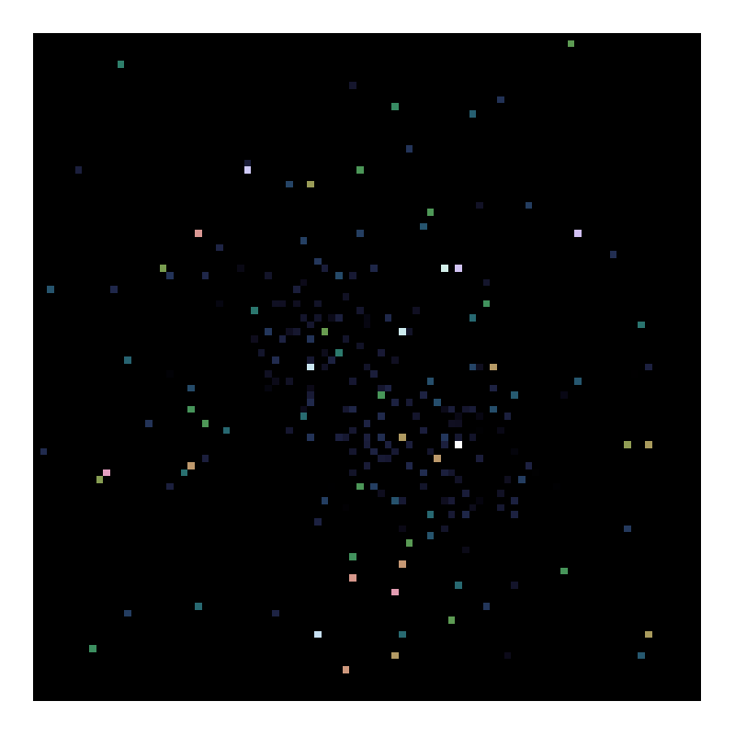
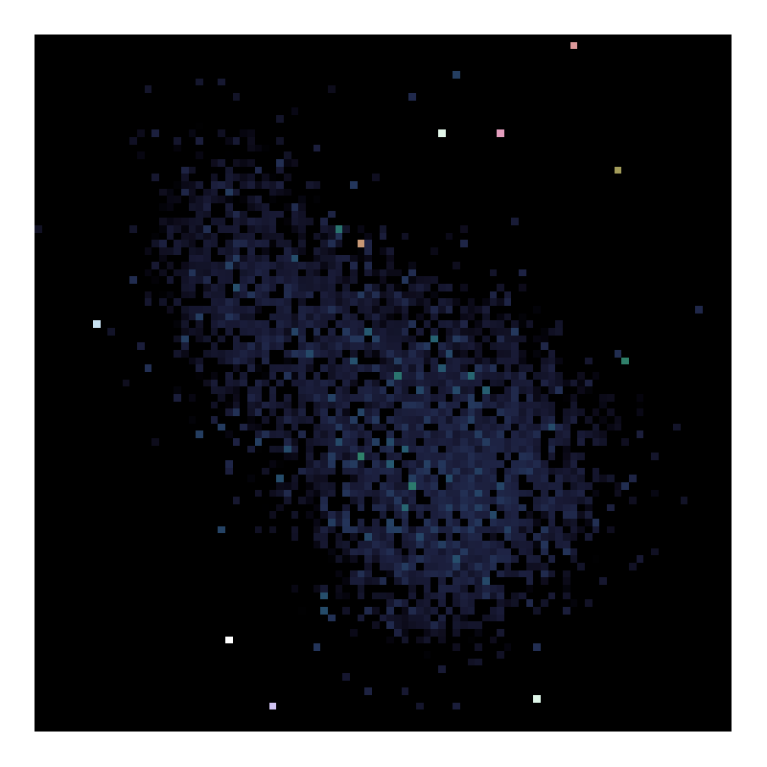
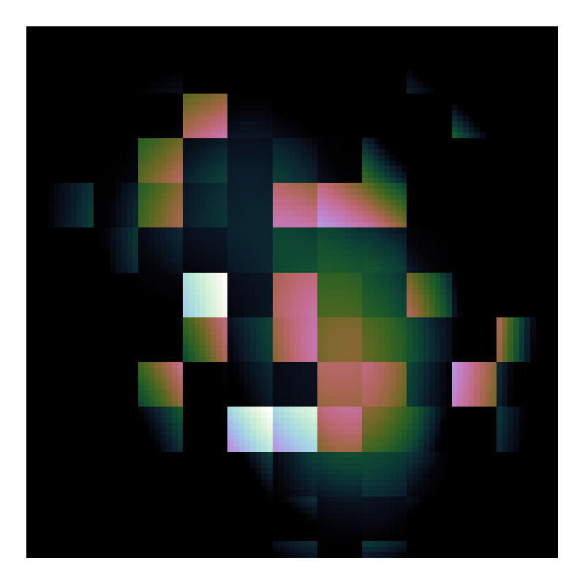
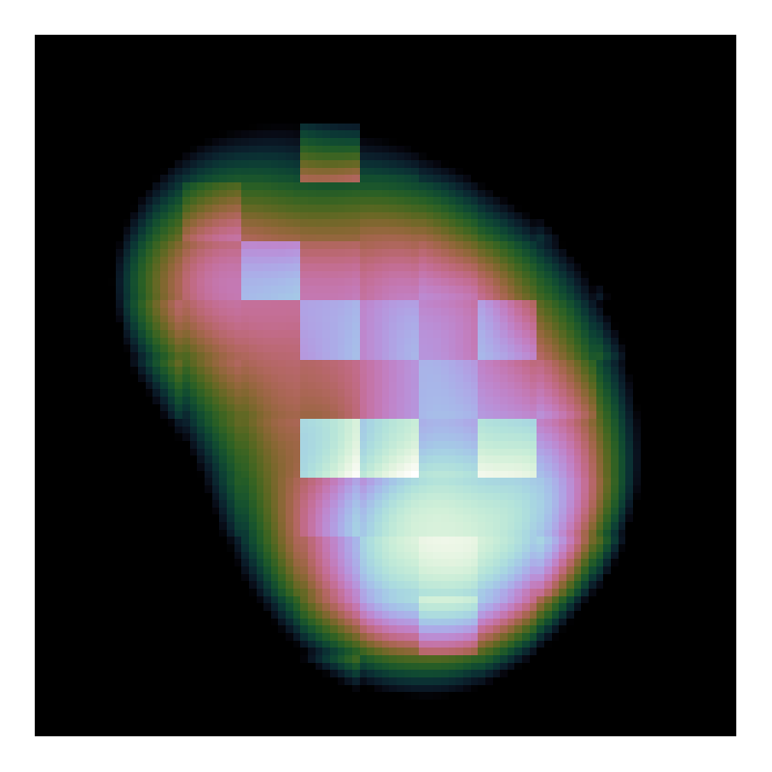
Random Pixel Selection

Slide 21
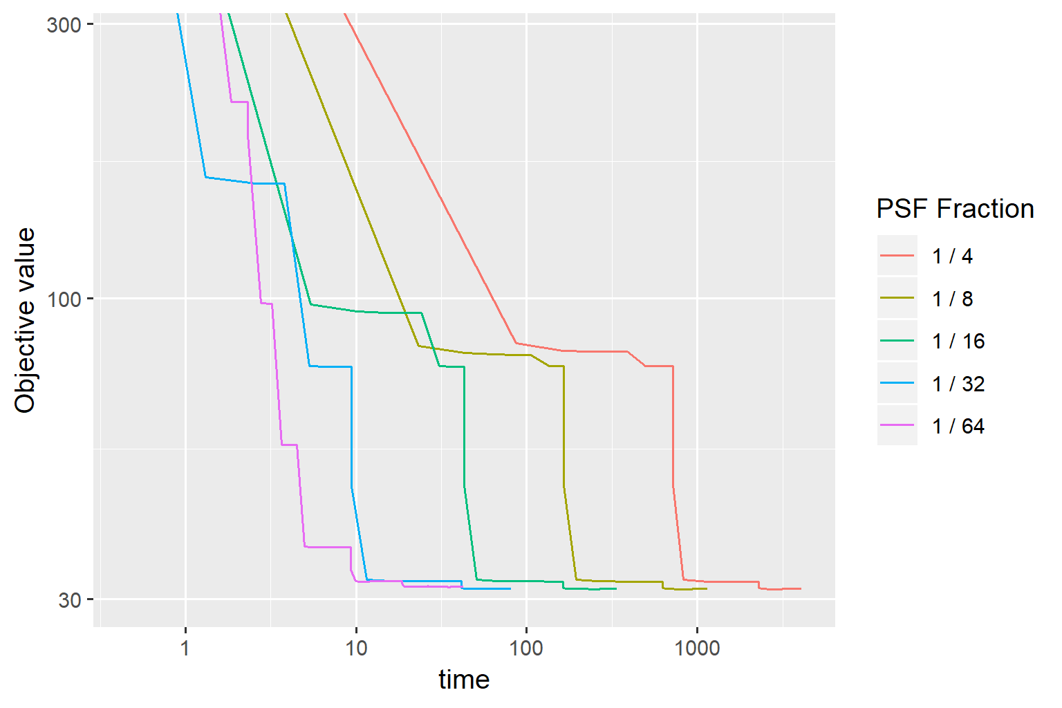
Speedup PCDM

Slide 22
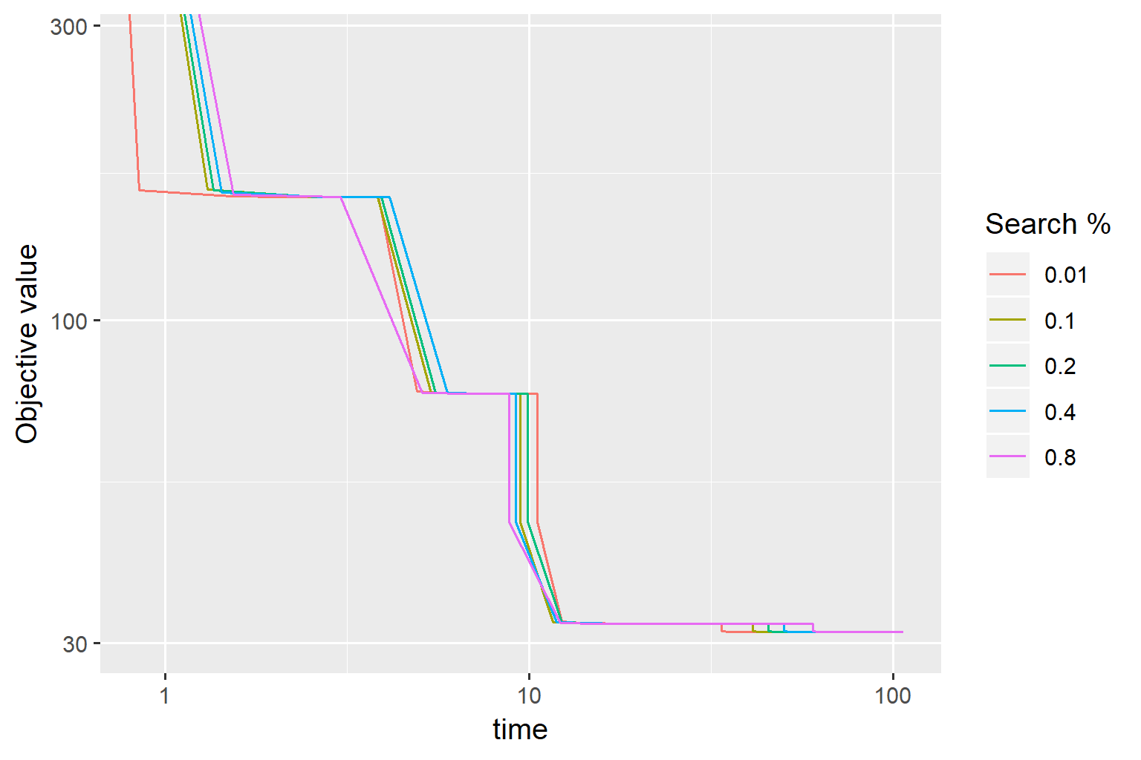

Slide 23
Speed comparison to CLEAN

Slide 24
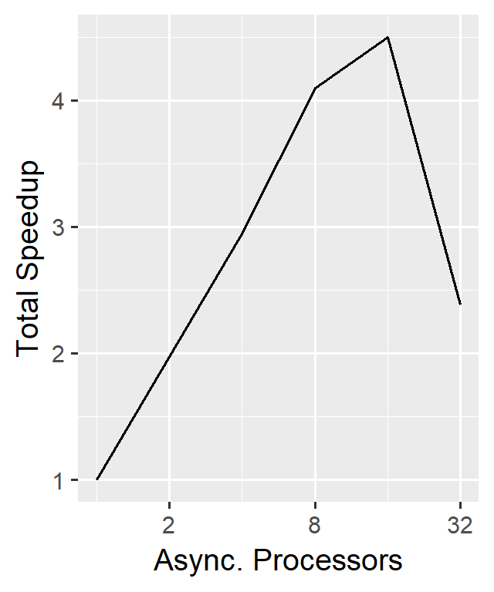
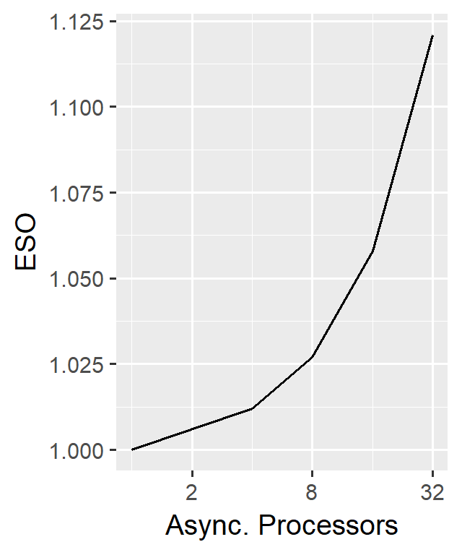
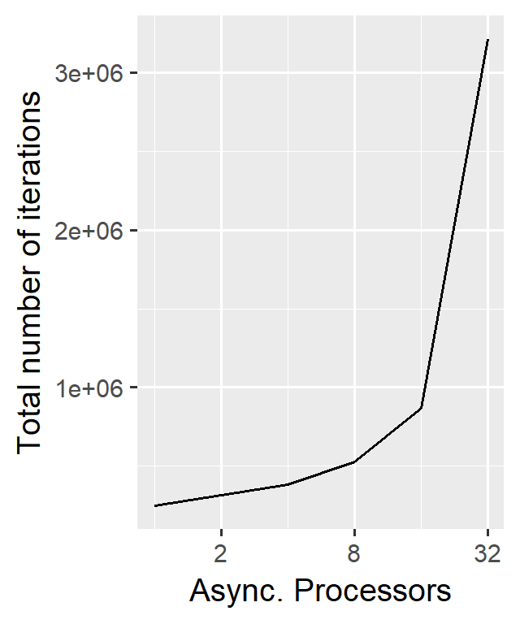
Scalability

Slide 25
Test
Table

Slide 26
Conclusion
Problem with facets
How much distribution
How useful is elasticnet

Slide 27
Conclusion 2
Fast algorithm. Possible to distribute

